Slide 1

More Computational Complexity: The Searching Problem
Chapter 8

Slide 2
Objectives
Establish a lower bound on searching by comparison of keys of n distinct keys for key x.
Prove binary search is optimal
Apply interpolation search to evenly distributed data
Differentiate between static and dynamic searching
Establish the average binary search tree search time

Slide 3
Objectives
Determine lower bounds on finding largest and smallest keys
Define a linear-time algorithm to find the k^{th} smallest key in an array of n distinct keys

Slide 4
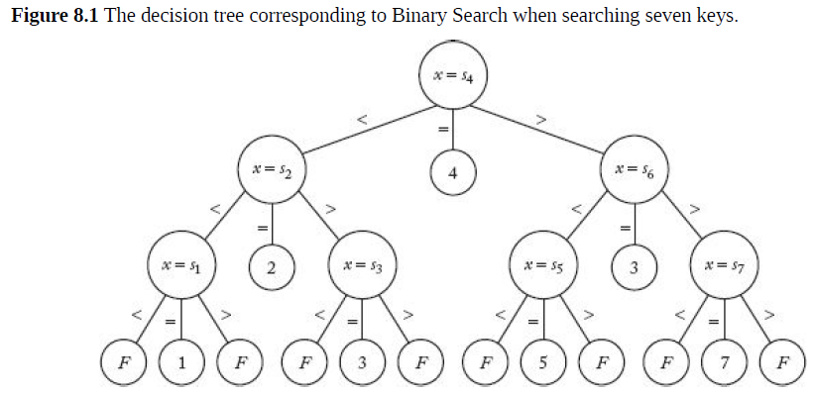
Binary Search
Algorithm 2.1
W(n) = ⎣lg n⎦ + 1
Establish binary search algorithm is optimal
Establish a lower bounds for searching only by comparison of keys

Slide 5
Decision Tree Binary Search
Every algorithm that searches for key x in an array of n keys has a corresponding pruned, valid decision tree
Leaf represents a point where algorithm stops and reports an index of x or failure
Every internal node represents a comparison
Valid if for each possible outcome, there is a path from the root to a leaf reporting that outcome
Pruned if every leaf is reachable

Slide 6
Pruned, valid Decision Tree
3 different results: >, =, <
Decision node can have at most three children
Equality is a leaf returning index
At most 2 children can be comparison nodes
Therefore, # comparisons is a binary tree

Slide 7
Establish a lower bound on the number of comparisons
Every node reachable: worst case comparison nodes on longest path
Number of nodes on the longest path from the root to a leaf in the binary tree consisting of comparison of nodes
Number of comparisons is the depth+1

Slide 8
Lemma 8.1
Establish a lower bound on the depth of the binary tree consisting of comparison nodes
If n is the number of nodes in a binary tree
and d is the depth:
d >= ⎣lg n⎦

Slide 9
Proof Lemma 8.1
At most one root, At most 2 nodes with depth 1, At most 2² nodes with depth 2, . . . , At most 2^{d} nodes with depth d
n <= 1 + 2 + 2² + . . . + 2^{d}
A3:
=> n <= 2^{d+1} - 1
=> n< 2^{d+1}
Take lg of both sides
lg n < lg 2^{d+1}
=>lg n < (d+1)lg 2 = d+1
=> ⎣lg n⎦ <= d

Slide 10
Lemma 8.2
To be a pruned, valid decision tree for searching n distinct keys for a key x, the binary tree consisting of the comparison nodes must contain at least n nodes

Slide 11
Steps of Proof by Contradiction
Let s_{i} for i ε <1..n> be the values of the n keys.
Show that every s_{i} must be in at least one comparison node
Show that since every s_{i} must be in a comparison node there must be n comparison nodes

Slide 12
Theorem 8.1
Any deterministic algorithm that searches for a key x in an array of n distinct keys only by comparisons of keys must in the worst case do at least
⎣lg n⎦ + 1 comparisons of keys

Slide 13
Proof Theorem 8.1
Given a pruned, valid decision tree for the algorithm that searches n distinct keys for a key x
Worst-case number of comparisons is the number of nodes on the longest path from the root to a leaf in the binary tree of comparison nodes: d + 1
By Lemma 8.2, the binary tree has at least n nodes
By Lemma 8.1, d >= ⎣lg n⎦

Slide 14
Interpolation Search
an improvement over Binary Search for instances, where the values in a sorted array are uniformly distributed.
interpolation constructs new data points within the range of a discrete set of known data points.
Binary Search always goes to the middle element
interpolation search may go to different locations according to the value of the key being searched.
For example, if the value of the key is closer to the last element, the interpolation search is likely to start search toward the end side.

Slide 15
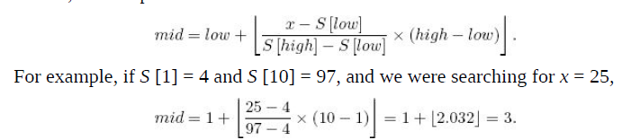
Interpolation Search
Given an application, data is evenly distributed in the search array
Instead of starting the search at mid, make the decision based on the value of x
Use linear interpolation to determine where x should be located

Slide 16
Volatility of data
Static Searching: records are added to the file one at a time. Once file established, records never added or deleted.
Array appropriate storage/search structure
Dynamic Searching: records frequently added/deleted (e.g. airline reservation system)
Binary Search Tree
Notes:
We next discuss that even though Binary Search and its variations, Interpolation
Search and Robust Interpolation Search, are very efficient, they cannot be used
in many applications because an array is not an appropriate structure for storing
the data in these applications. Then we show that a tree is appropriate for these
applications. Furthermore, we show that we have Θ (lg n) algorithms for
searching trees.
An array structure is inappropriate for dynamic searching, because when we
add a record in sequence to a sorted array, we must move all the records
following the added record. Binary Search requires that the keys be structured in
an array, because there must be an efficient way to find the middle item. This
means that Binary Search cannot be used for dynamic searching. Although we
can readily add and delete records using a linked list, there is no efficient way to
search a linked list. Therefore, linked lists do not satisfy the searching needs of a
dynamic searching application. If it is necessary to retrieve the keys quickly in
sorted sequence, direct-access storage (hashing) will not work (hashing is
discussed in the next section). Dynamic searching can be implemented
efficiently using a tree structure

Slide 17
Binary Search Tree
Tree of items from an ordered set such that
Each node contains one key
Keys in the left subtree of a given node are less than or equal or the key in that node
Keys in the right subtree of a given node are greater than or equal to the key in that node

Slide 18
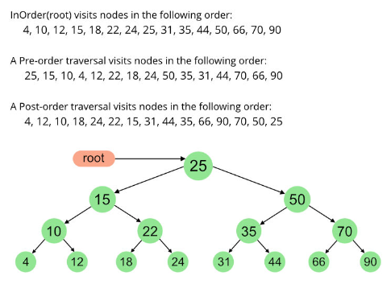
In-order traversal
Visit all nodes in the left subtree using in-order traversal
Visit root
Visit all nodes in the right subtree using in-order traversal
Produces sorted order of keys
Notes:
Furthermore, we can quickly retrieve the keys in sorted sequence
by doing an in-order traversal of the tree. Recall that in an in-order traversal of a
binary tree, we traverse the tree by first visiting all the nodes in the left subtree
using an in-order traversal, then visiting the root, and finally visiting all the
nodes in the right subtree using an in-order traversal.

Slide 19
Theorem 8.3
Assume all inputs are equally probable and that the search key x is equally probable to be any of the n keys, the average search time over all inputs containing n distinct keys using binary search trees is given approximately by A(n) ≈ 1.38 lgn
Theorem 8.3 does not mean the average for a given input is 1.38 lgn
Theorem 8.3 is the average search time over all inputs containing n keys input
Notes:
Theorem 8.3 is for the average search time over all inputs containing
n keys. Therefore, for any given input containing n keys, it is probable that the
average search time is in Θ (lg n) but it could be in Θ (n). There is no guarantee
of an efficient search.

Slide 20
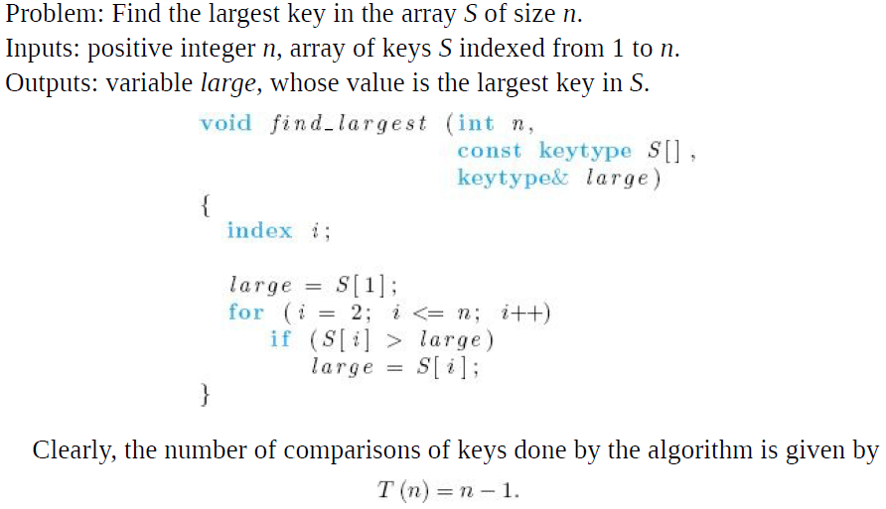
Selection Problem
Theorem 8.7: Any deterministic algorithm that can find the largest of n keys in every possible input only by comparisons of keys must in every case do at least
n-1 comparisons of keys
Proof by contradiction
Notes:
Next we address
a different searching problem called the Selection problem. This problem is to
find the kth-largest (or kth-smallest) key in a list of n keys. We assume that the
keys are in an unsorted array (the problem is trivial for a sorted array).

Slide 21
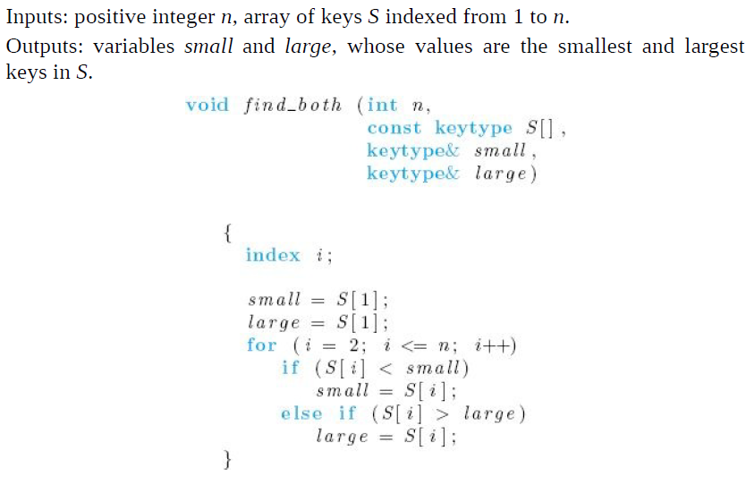
Find the smallest and largest key

Slide 22
Find the smallest and largest key
Worst case is when S[1] is the smallest key, second comparison is done for all i
W(n) = 2(n-1)
Improve?
Notes:
Using Algorithm 8.3 is better than finding the smallest and largest keys
independently, because for some inputs the comparison of S [i] with large is not
done for every i. Therefore, we have improved on the everycase performance.
But whenever S [1] is the smallest key, that comparison is done for all i.
Therefore, the worst-ease number of comparisons of keys is given by
which is exactly the number of comparisons done if the smallest and largest keys
are found separately.
It may seem that we cannot improve on this performance,
but we can. The trick is to pair the keys and find which key in each pair is
smaller. This can be done with about n/2 comparisons. We can then find the
smallest of all the smaller keys with about n/2 comparisons and the largest of all
the larger keys with about n/2 comparisons. In this way, we find both the
smallest and largest keys with only about 3n/2 total comparisons. An algorithm
for this method follows. The algorithm assumes that n is even.

Slide 23
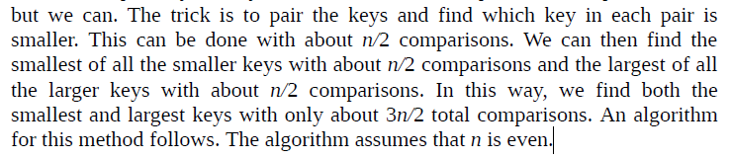
Find the smallest and largest key
Worst case is when S[1] is the smallest key, second comparison is done for all i
W(n) = 2(n-1)
Improve?
Notes:
Using Algorithm 8.3 is better than finding the smallest and largest keys
independently, because for some inputs the comparison of S [i] with large is not
done for every i. Therefore, we have improved on the everycase performance.
But whenever S [1] is the smallest key, that comparison is done for all i.
Therefore, the worst-ease number of comparisons of keys is given by
which is exactly the number of comparisons done if the smallest and largest keys
are found separately.
It may seem that we cannot improve on this performance,
but we can. The trick is to pair the keys and find which key in each pair is
smaller. This can be done with about n/2 comparisons. We can then find the
smallest of all the smaller keys with about n/2 comparisons and the largest of all
the larger keys with about n/2 comparisons. In this way, we find both the
smallest and largest keys with only about 3n/2 total comparisons. An algorithm
for this method follows. The algorithm assumes that n is even.

Slide 24
Find smallest and largest keys by pairing keys
Assume n is even
Pair i₁ and i₂ , i₃ and i₄ , . . . , i_{j} and i_{j+1} ,. . . , i_{n-1} and i_{n}
Find the largest of the pair: i_{l} and compare it with the largest so far
Compare the other key of the pair with the smallest so far
Iterate loop by 2 instead of 1
n is even: T(n) = 3n/2 – 2
n is odd: T(n) = 3n/2- 3/2

Slide 25
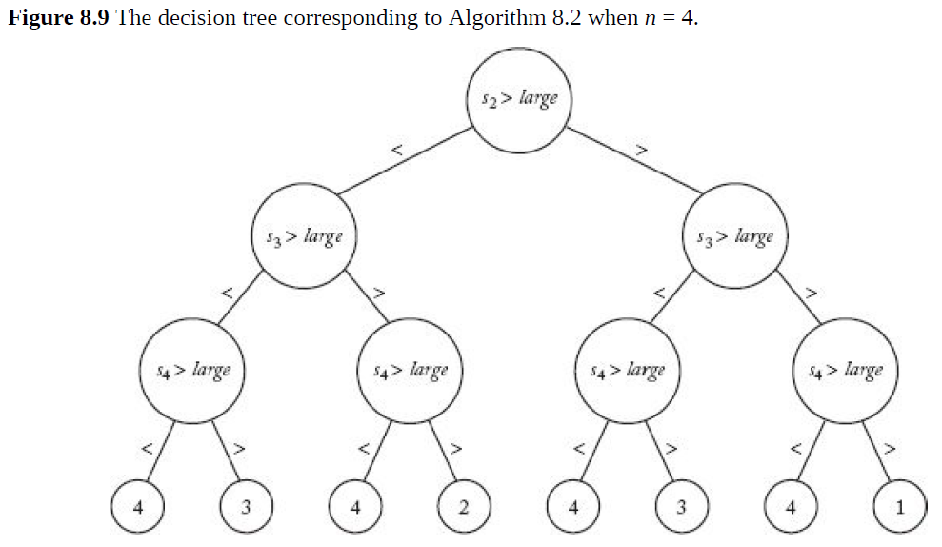

Slide 26
Theorem 8.8
Any deterministic algorithm that can find both the smallest and the largest of keys in every possible input only by comparisons of keys must in the worst case do at least:
3n/2 – 2 if n is even
3n/2 – 3/2 if n is odd

Slide 27
Algorithm 8.5
Find the k^{th} smallest key in an array S of n distinct keys
Could sort the array in nlg(n) time and take the k^{th} smallest
Use Algorithm 2.7, partition from quicksort
Recursively partition the left sub-array if k is less than pivotpoint
Recursively partition the right sub-array if k is greater than pivotpoint
Notes:
One way to find the kth-smallest key in Θ (n lg n) time is to sort the keys and
return the kth key. We develop a method that requires fewer comparisons.
Recall that procedure partition in Algorithm 2.7, which is used in Quicksort
(Algorithm 2.6), partitions an array so that all keys smaller than some pivot item
come before it in the array and all keys larger than that pivot item come after it.
The slot at which the pivot item is located is called the pivotpoint. We can solve
the Selection problem by partitioning until the pivot item is at the kth slot. We do
this by recursively partitioning the left subarray (the keys smaller than the pivot
item) if k is less than pivotpoint, and by recursively partitioning the right
subarray if k is greater than pivotpoint. When k = pivotpoint, we’re done. This
divide-and-conquer algorithm solves the problem by this method.

Slide 28
Algorithm 8.5
W(n) = n(n-1)/2
A(n) ε θ(n)
Can quadratic time worst case be prevented?

Slide 29
Pivotpoint
Split array in the middle
Input cut in half each recursive call
Median of n distinct keys (precise if n is odd)
Half of the keys smaller
Half of the keys larger

Slide 30
Assume n is an odd multiple of 5
Divide n keys into n/5 groups of keys each containing 5 keys
Find the median of each of the groups directly
The median of 5 items can be found with 6 comparisons (see exercises)
Call selection to find the median of the n/5 medians
Median of n/5 medians not necessarily the median of the n elements but will be close
pivotitem is the median of the medians
Partition around pivotitem – optimal pivotpoint

Slide 31
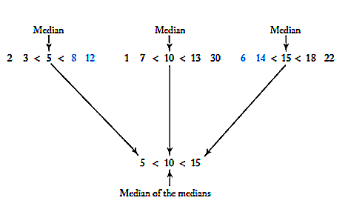
Figure 8.12

Slide 32
Keys n is an odd multiple of 5
Number of keys known to be on one side of the median of the medians: ½[n - 1 – 2(n/5 – 1)]
Number of keys that could be on either side of the median of the medians: 2(n/5 – 1)
At most ½[n - 1 – 2(n/5 – 1)] + 2(n/5 – 1) = 7n/10 – 3/2 keys on one side of the median of the medians

Slide 33
Worst-Case Time Complexity (Selection Using the Median)
Basic operation: comparison of S[i] with pivotitem in partition2
Input size: n
Recurrence assumes n is an odd multiple of 5 (holds for n in general)
Time in function selection2 when called from selection 2
At most 7n/10 – 3/2 keys on one side of the pivotpoint (worst case number of keys in call)

Slide 34
Worst-Case Time Complexity (Selection Using the Median)
Time in selection2 when called from partition2
Number of keys is n/5 (n/5 medians)

Slide 35
Worst-Case Analysis Continued
Number of comparisons required to find medians:
6 comparisons (see exercises)
n/5 groups of 5 => total number of comparisons 6n/5
Number of comparisons required to partition the array => n
W(n) = W(7n/10 – 3/2) + W(n/5) + 6n/5 + n
W(n) ≈ W(7n/10) + W(n/5) + 11n/5
Recurrence does not indicate any obvious solution

Slide 36
Constructive Induction used to obtain Candidate Solution
Suspect W(n) is linear
Assume W(m) <= cm for all m < n and for some constant c
Recurrence implies
W(n) ≈ W(7n/10) + W(n/5) + 11n/5
<=c(7n/5) + c(n/5) + 11n/5
To conclude W(n) <= cn solve
<=c(7n/5) + c(n/5) + 11n/5
22<=c
W(n) ε θ(n)

